Slide 1
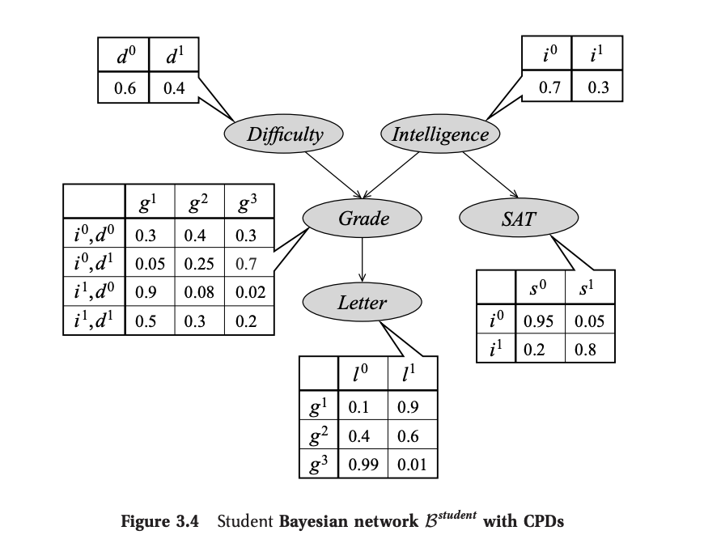
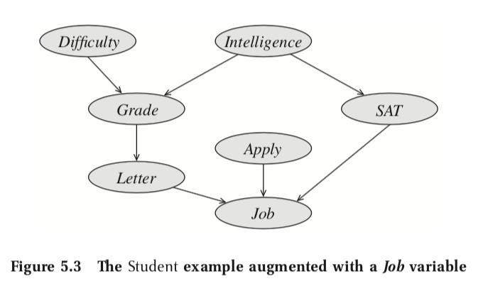
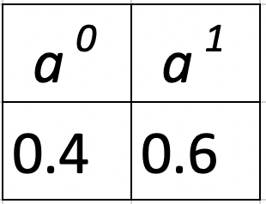
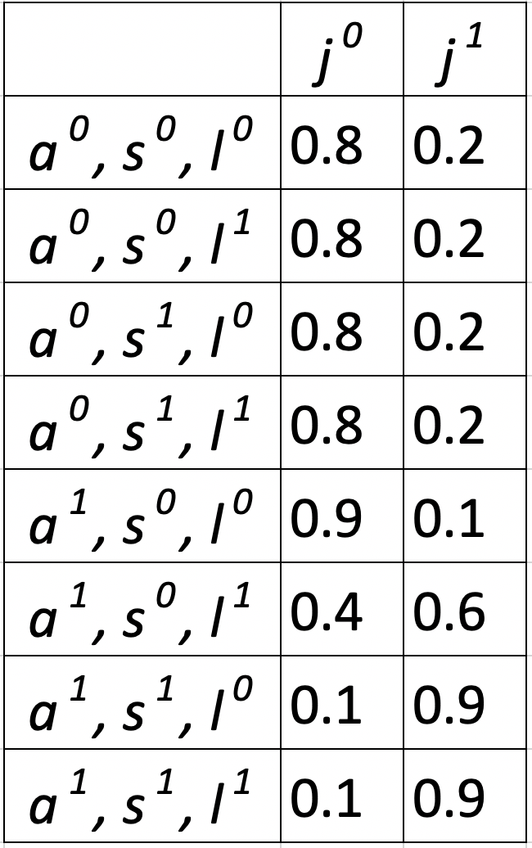
Joint Probability Inference
Explanation:
The most probable setting for all variables is:
student is not intelligent;
course is difficult;
C grade in course;
low score on SAT;
Weak letter of recommendation;
student applies for the job;
student does not get the job.
Formula:
Similarly, we have calculated joint probability for each of 192 combinations of input variables.
Notes:
Github code: https://github.com/Mihir2/Student_Bayesian_Network/blob/master/PGM-Student.ipynb
P(I,D,G,S,L,A,J) = P(I)P(D)P(G|I,D)P(S|I)P(L|G)P(A)P(J|A,S,L)
P(I,D,G,S,L,A,J) = 0.4 * 0.7 * 0.7 * 0.99 * 0.95 * 0.6 * 0.9

Slide 2
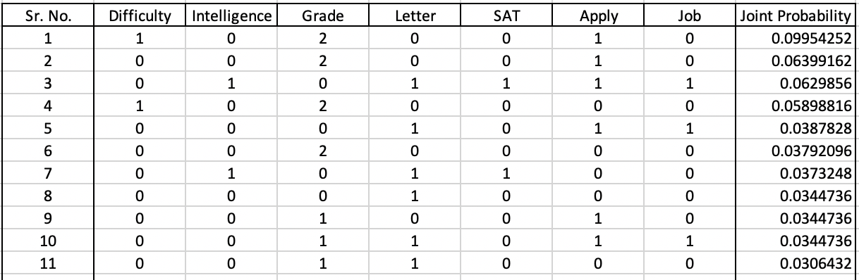
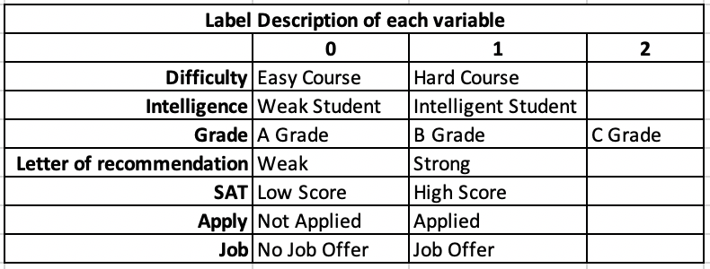
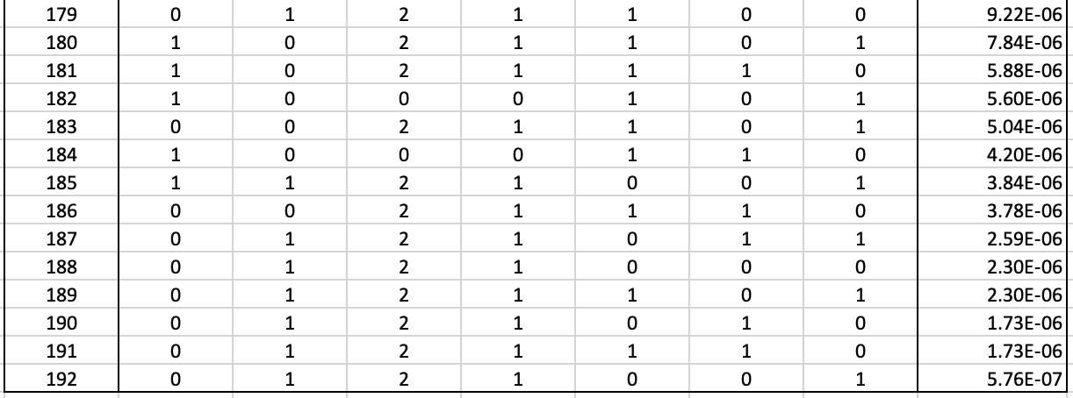
Joint Probability Inference - Combinations
most probable setting
…
…
…
Notes:
Github code: https://github.com/Mihir2/Student_Bayesian_Network/blob/master/PGM-Student.ipynb
P(I,D,G,S,L,A,J) = P(I)P(D)P(G|I,D)P(S|I)P(L|G)P(A)P(J|A,S,L)
P(I,D,G,S,L,A,J) = 0.4 * 0.7 * 0.7 * 0.99 * 0.95 * 0.6 * 0.9

Slide 3
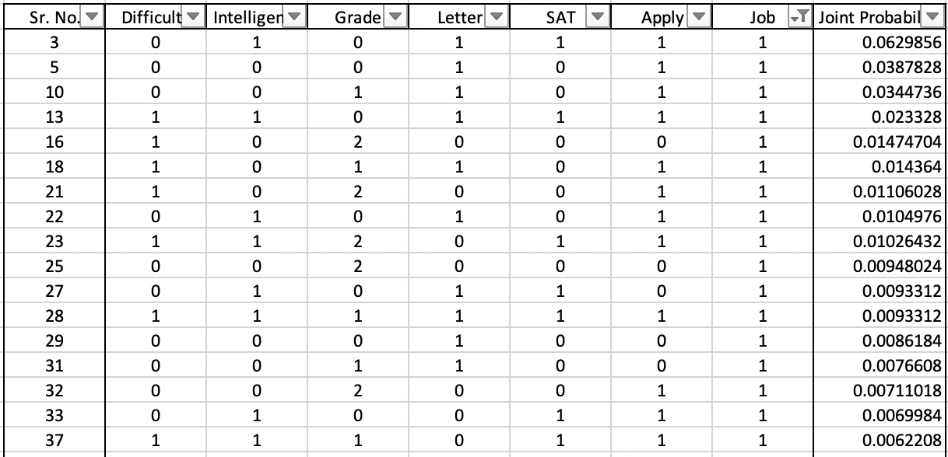
Conditional Probability MAP Inference given Job
Explanation:
The most probable explanation given student gets job is:
student is intelligent;
course is easy;
A grade;
High score on his SAT;
Strong letter of recommendation;
Applied for the job;
Formula:
Notes:
Github code: https://github.com/Mihir2/Student_Bayesian_Network/blob/master/PGM-Student.ipynb
P(I,D,G,S,L,A|J=1) = P(I,D,G,S,L,A) / P(J=1)
P(I,D,G,S,L,A,J) = P(I)P(D)P(G|D,I)P(L|G)P(S|I)P(A)P(J|A,S,L)

Slide 4
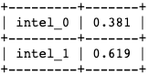
Intelligence MAP Inference given Job = 1
Explanation:
The most probable explanation given student gets job is:
student is intelligent;
Probability of Student
Intelligence
Formula:
Notes:
Github code: https://github.com/Mihir2/Student_Bayesian_Network/blob/master/PGM-Student.ipynb
P(I|J=1) = P(I) / P(J=1)
I = i_{1}, D = d_{0}, G = g_{0}, L = l_{1}, S = s_{1}, A = a_{1}, J = j_{1}
P(I = 0, J = 1) = 0.9*0.6*0.8*0.9*0.9*0.3*0.6 = 0.0629856
I = i_{0}, D = d_{0}, G = g_{0}, L = l_{1}, S = s_{0}, A = a_{1}, J = j_{1}
P(I = 1, J = 1) = 0.9*0.6*0.8*0.9*0.9*0.3*0.6 = 0.0387828
P(I = 0 | J = 1) = 0.0387/(0.0629+0.0387) = 0.381

Slide 5
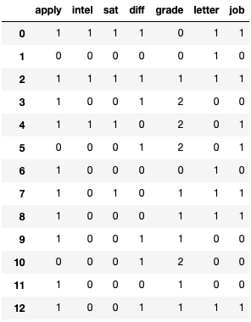
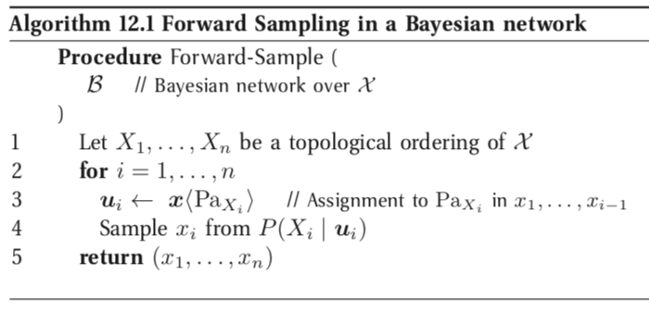
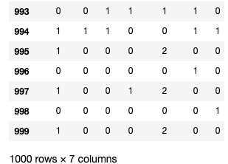
Forward Sampling from Student Bayesian Network
…
…
PGMPY:
Notes:
Github code: https://github.com/Mihir2/Student_Bayesian_Network/blob/master/PGM-Student.ipynb

Slide 6
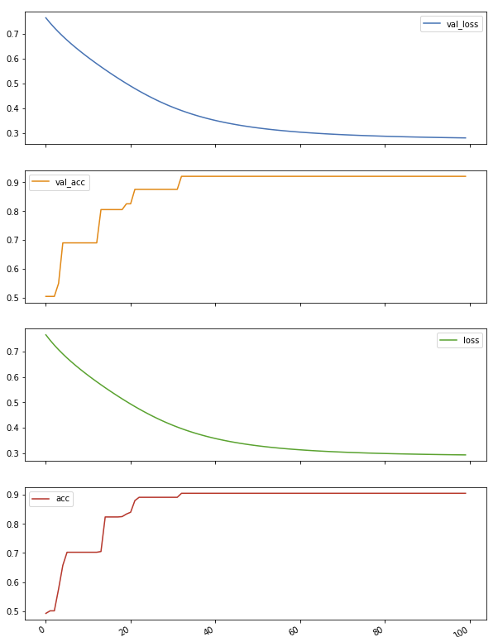
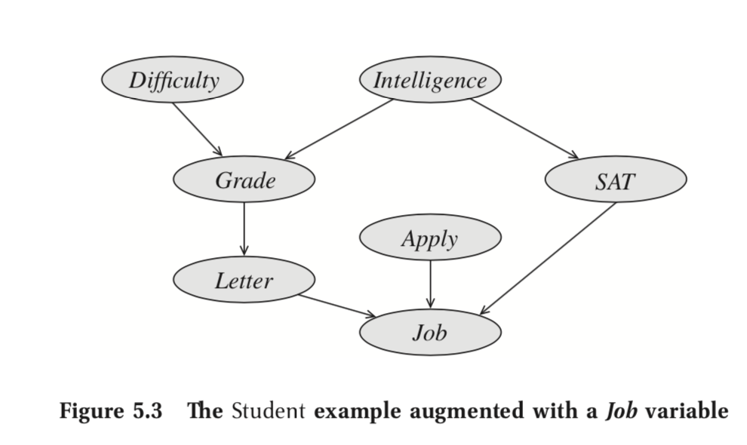
Logistic Regression over 1000 samples (Input J, S, L) (Augmented student BN)
Training Hyperparameters:
Number of Epochs: 100
Batch Size: 100
Number of samples: 1000
Number of Training samples: 800
Number of Validation samples: 200
Results:
Training Accuracy: 90.5%
Training Loss: 0.293
Testing Accuracy: 92%
Testing Loss: 0.2802
Job
Sigmoid
Activation
SAT
Intelligence
Letter
Bias
Notes:
Github code: https://github.com/Mihir2/Student_Bayesian_Network/blob/master/PGM-Student.ipynb

Slide 7
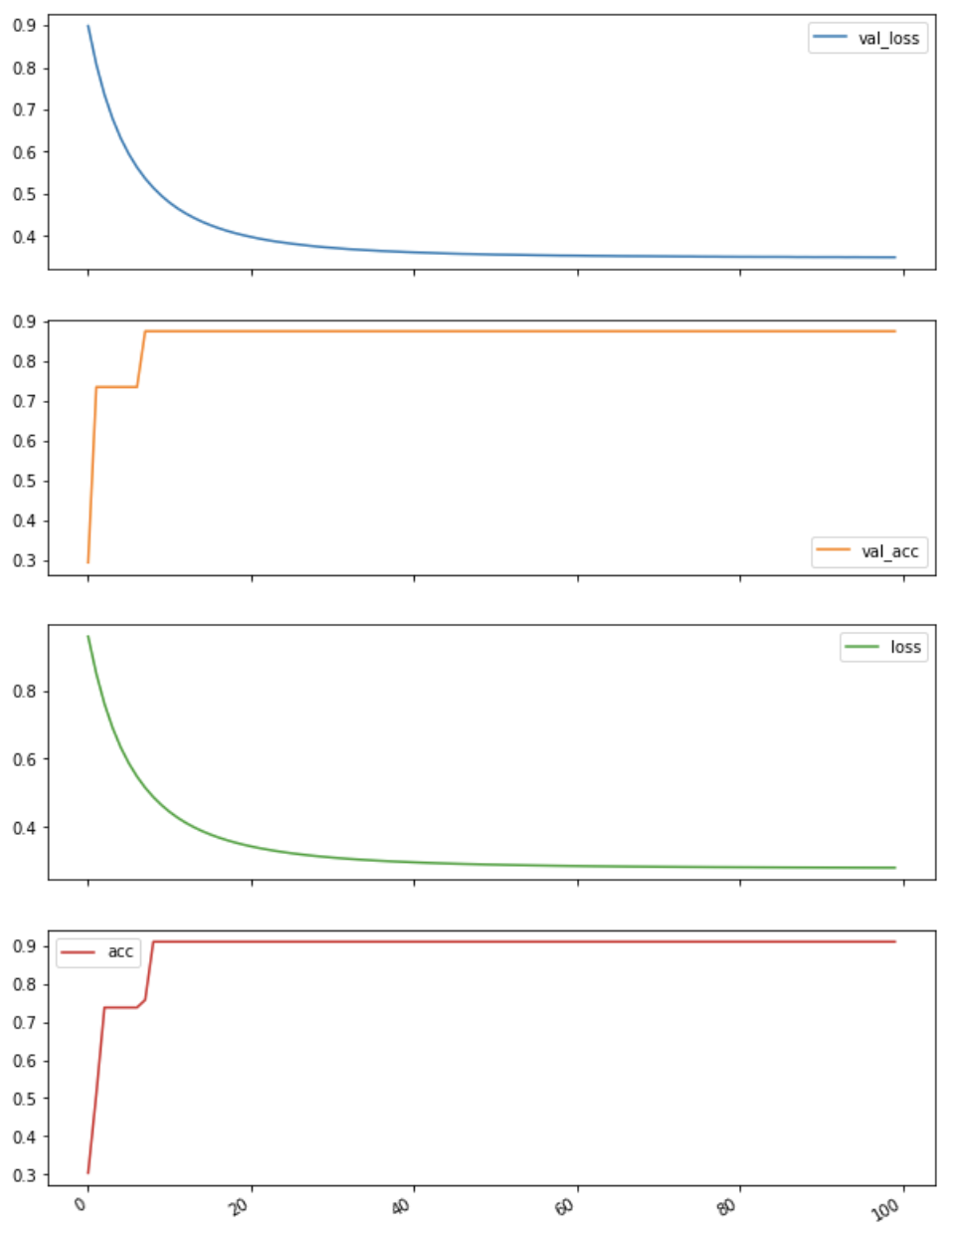
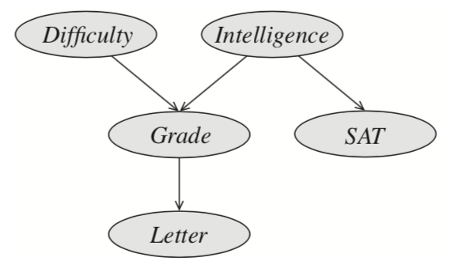
Logistic Regression over 1000 samples (Input S, L) (Unaugmented student BN)
Training Hyperparameters:
Number of Epochs: 100
Batch Size: 100
Number of samples: 1000
Number of Training samples: 800
Number of Validation samples: 200
Results:
Training Accuracy: 90.5%
Training Loss: 0.2815
Testing Accuracy: 92%
Testing Loss: 0.3494
SAT
Softmax
Activation
Letter
Intelligence
Unaugmented Student Bayesian Network
Bias
Notes:
Github code: https://github.com/Mihir2/Student_Bayesian_Network/blob/master/PGM-Student.ipynb

Slide 8
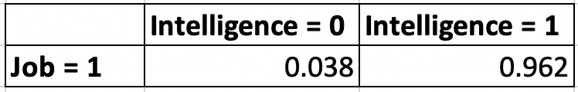
Probability of Intelligence given Job = 1 (Logistic Regression over samples from Augmented student BN)
Training Hyperparameters:
Number of Epochs: 100
Batch Size: 100
Number of samples: 1000
Number of Training samples: 800
Number of Validation samples: 200
Results:
Training Accuracy: 94.62%
Training Loss: 0.1580
Testing Accuracy: 96%
Testing Loss: 0.1534
Logistic Regression output:
Explanation:
Softmax
The most probable explanation given student gets job is:
96.2% probability that student is intelligent;
Intelligence = {0}
Job = {0, 1}
Formula:
Intelligence = {1}
Bias
Notes:
Github code: https://github.com/Mihir2/Student_Bayesian_Network/blob/master/PGM-Student.ipynb

Slide 9
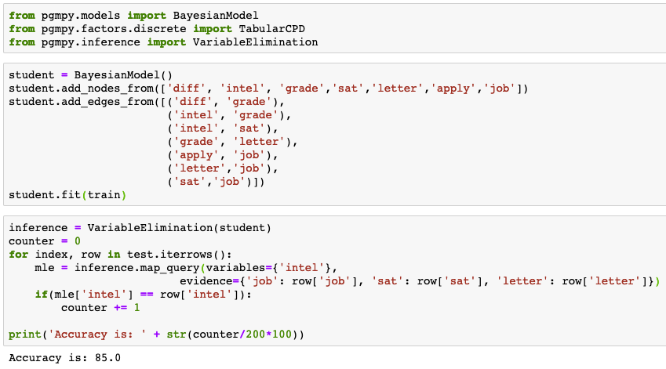
PGM classification over 1000 samples
Results:
Training Accuracy: 91.875%
Testing Accuracy: 88.5%
Notes:
Github code: https://github.com/Mihir2/Student_Bayesian_Network/blob/master/PGM-Student.ipynb

Slide 10
Explainable System v/s High performance system
Softmax
Intelligence = {0}
Job = {0, 1}
Intelligence = {1}
Bias
High Performance Results:
Training Accuracy: 94.62%
Training Loss: 0.1580
Testing Loss: 0.1534
Testing Accuracy: 96%
Explainable System Results:
Training Accuracy: 91.875%
Testing Accuracy: 88.5%

Slide 11
Appendix

Slide 12
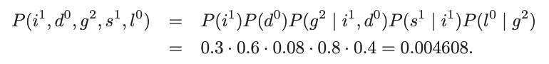
Joint Probability Inference
The probability that the
student is intelligent;
course is easy;
B in course;
high score on SAT;
gets a weak letter of recommendation
The total probability of this state is: 0.004608

Slide 13
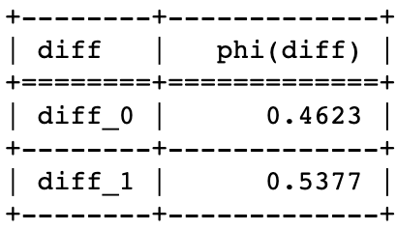
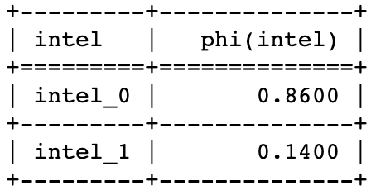
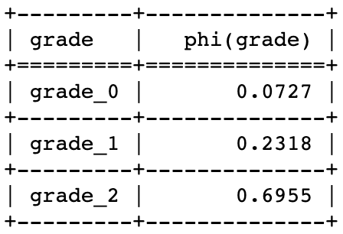
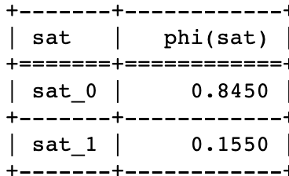
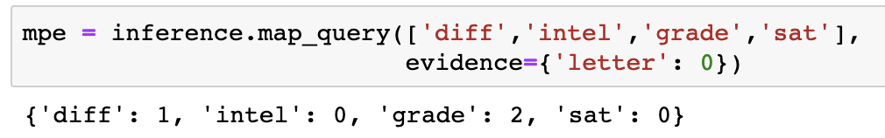
Conditional Probability Inference (MAP Query 1)
Given that professor gives a weak letter, the most probable explanation is that:
student is not intelligent;
course is difficult;
B grade in the course;
low score on SAT;
Hence, the student got a weak letter of recommendation
Probability of course Difficulty
Probability of student Intelligence
Probability of student grade
Probability of student SAT score
PGMPY:

Slide 14
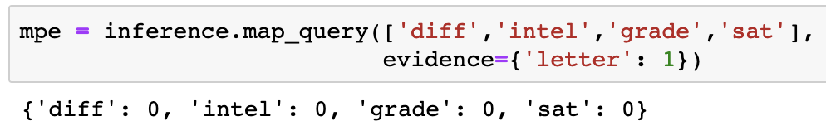
Conditional Probability Inference (MAP Query 2)
Given that professor gives a weak letter, the most probable explanation is that:
student is not intelligent;
course is easy;
high score in course;
high score on SAT;
Hence, the student got a strong letter of recommendation
Probability of course Difficulty
Probability of student Intelligence
Probability of student grade
Probability of student SAT score
PGMPY:

Slide 15
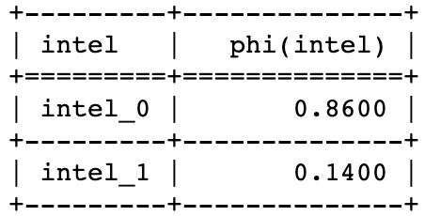
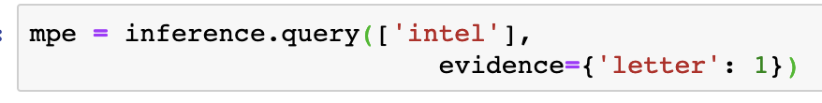
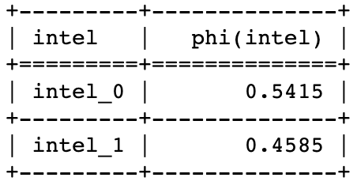
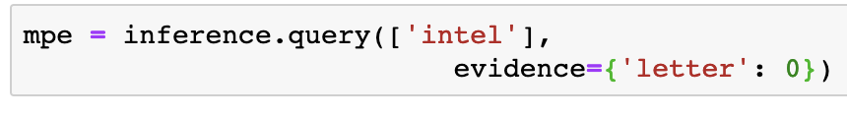
Conditional Probability Inference (MAP Query 3, 4)
Given that professor gives a weak letter or recommendation, the most probable explanation is that:
student is not intelligent;
Probability of student intelligence when recommendation is weak
Given that professor gives a strong letter of recommendation, the most probable explanation is that:
student may or may not be intelligent;
Probability of student intelligence when recommendation is strong

